Slide 1
CULTURE OF CARE AND CULTURE OF PEACE
Exchange students from Life-link schools (with students from border cities)
October 19 Arica (Chile) Tacna (Perú)
November 4th – 5th Arica (Chile) and Lima – Trujillo (Perú)

Slide 2
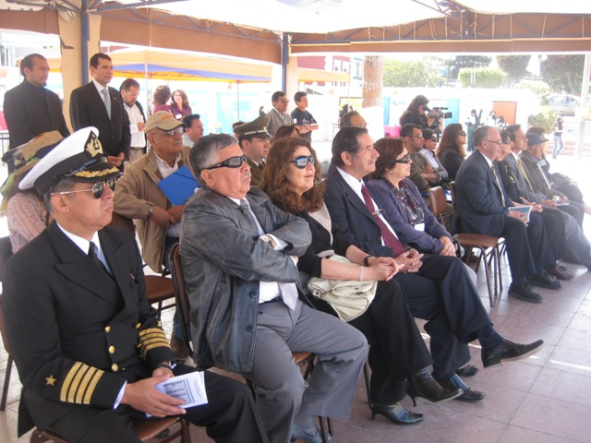
EXHIBITION ABOUT ENVIRONMENT IN ARICA CITY (CHILE) WITH THE ATTENDANCE OF AUTHORITIES AND GUESTS (October 19th)

Slide 3
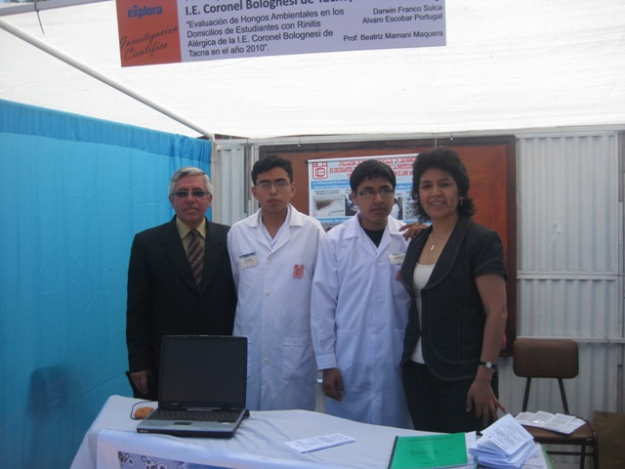
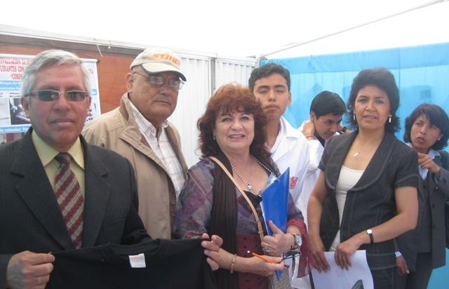
Life-link coordinators (october 19th)
Mrs. Gladys Hernández (Arica Chile)
Mr. Edgard Olavarría (Tacna Perú)
Students and teachers ARICA-TACNA

Slide 4
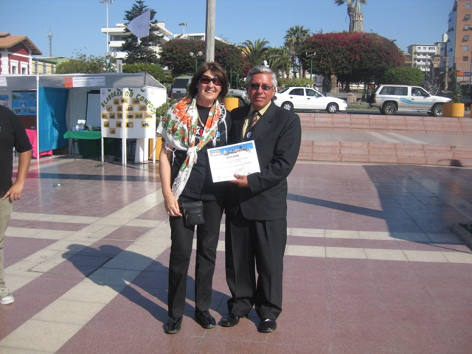
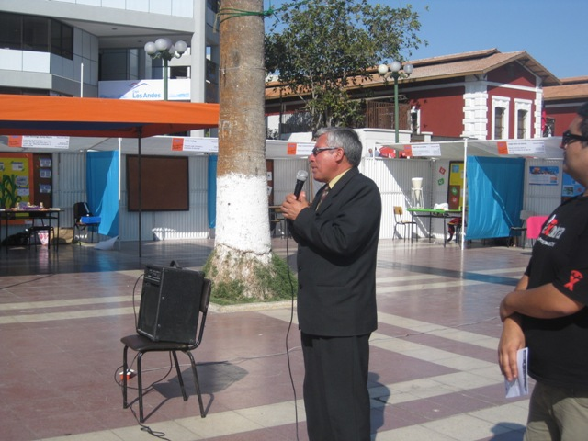
WORDS OF INTEGRATION AND CULTURE OF PEACE
MR. EDGARD OLAVARRIA TACNA –PERU
(October 19th)

Slide 5
LICEO ARTISTICO (Arica Chile)
EXCHANGE STUDENTS LIFE-LINK
(November 4th – 5th)
PRINCIPAL LICEO ARTISTICO MRS ANA SOTO
PRINCIPAL LICEO JUAN PABLO PEREGRINO LIMA-PERU MRS MERCEDES LOLI
PRINCIPAL LICEO MARISTA SIGLOXXI TRUJILLO- PERU
MR.CARLOS CHACALTANA

Slide 6
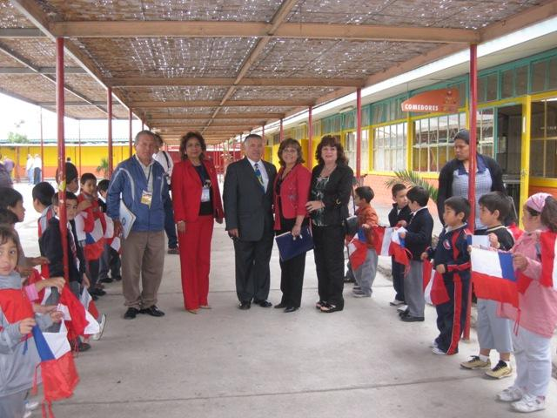
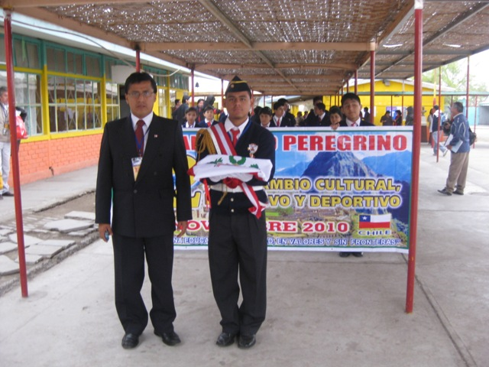
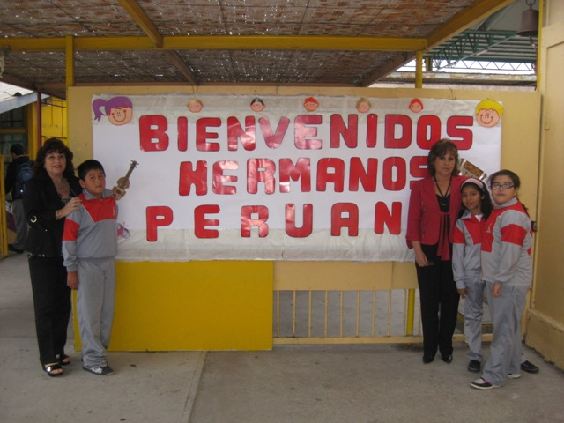
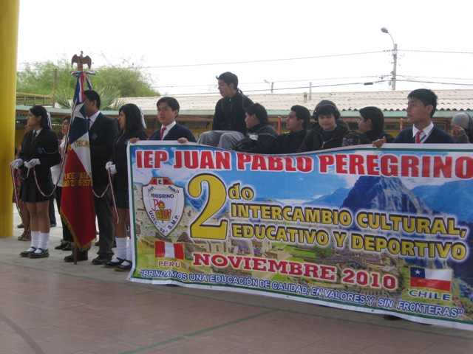
NOVEMBER 4th – 5th WELCOME

Slide 7
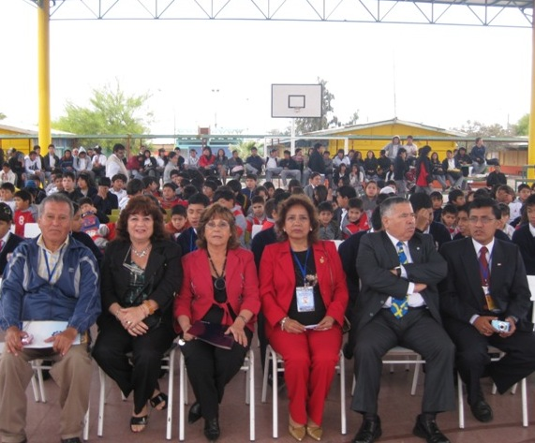
CIVIC ACT LICEO ARTISTICO

Slide 8
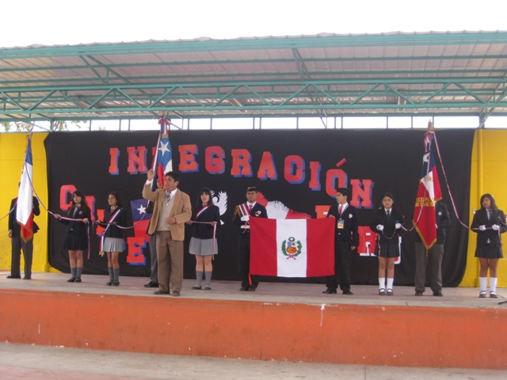
All the assistants sang the national hymn of each country (Chile and Perú)
The standarts of High Schools: Artistic, Jovina Naranjo, Politecnico, and Perú

Slide 9
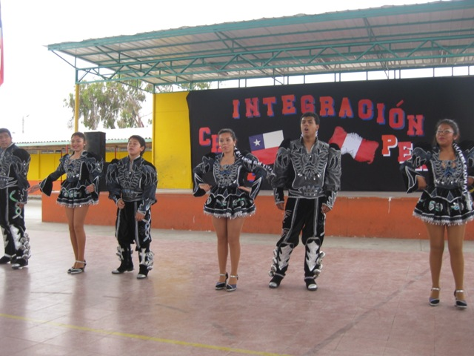
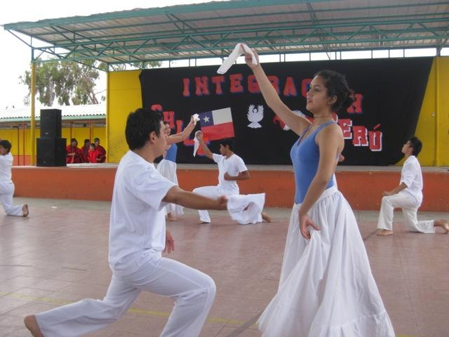
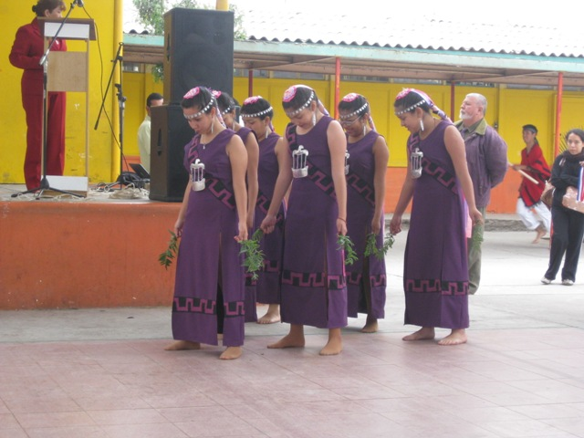
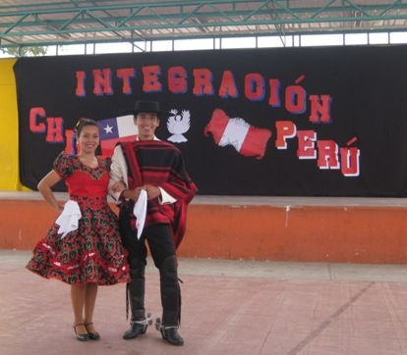
STUDENTS LICEO ARTISTICO

Slide 10
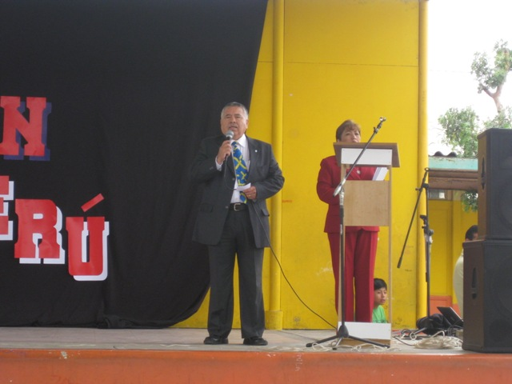
Words about Life-Link and Escuelas sin fronteras
Mr. Mario Vargas

Slide 11
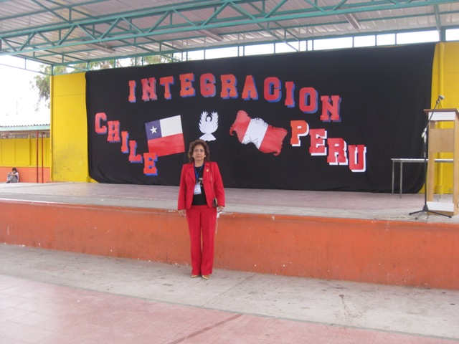
Words about Integration
Mrs. Mercedes Loli Principal Liceo Juan Pablo Peregrino (Lima Perú)

Slide 12
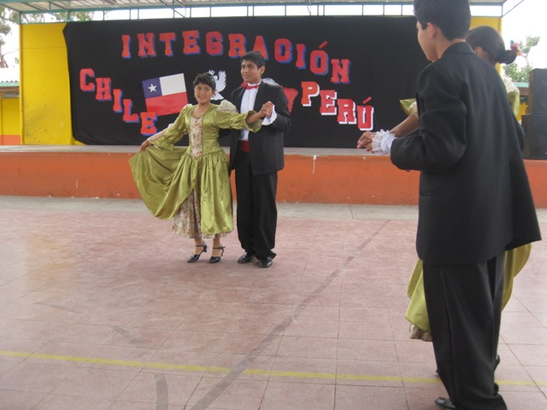
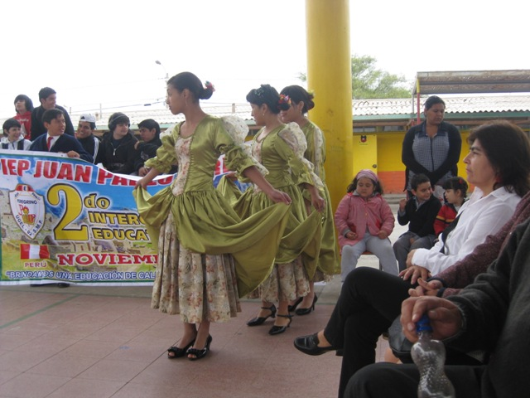
PERU
Students from Lima

Slide 13
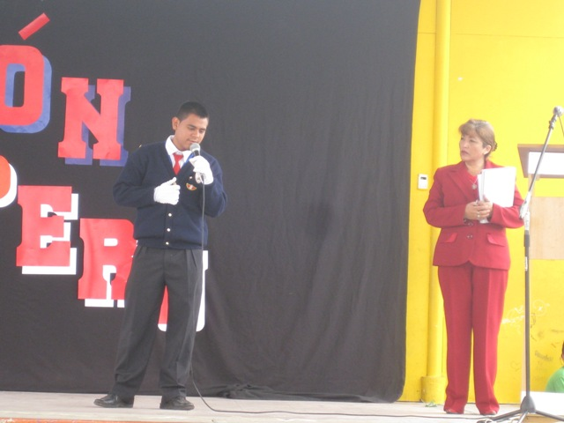
RECITING POETRY
Lima-Perú students

Slide 14
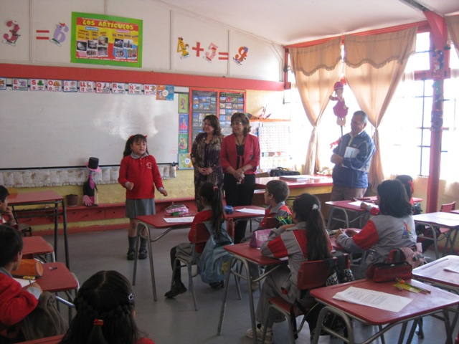
VISITING CLASS ROOM
RESULT ABOUT Life-Link GUIDE

Slide 15
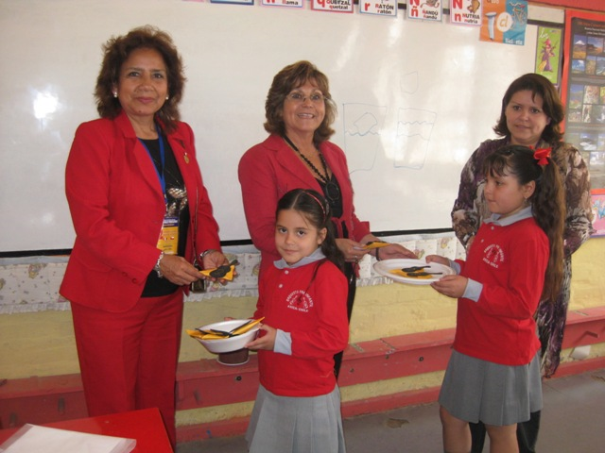
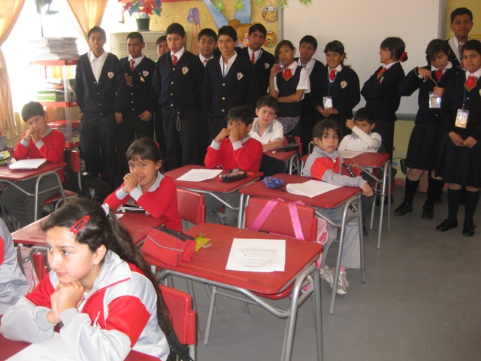
Mrs Mercedes Loli ( Peru),Ana Soto and Solange Araya
Chile Students Chile and Perú Students

Slide 16
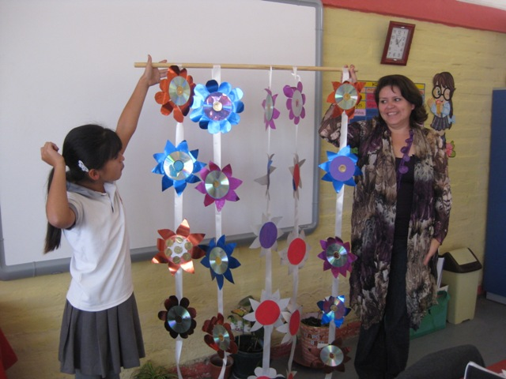
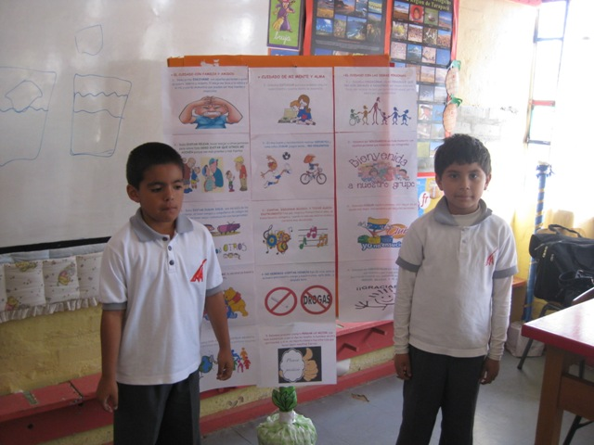
Culture of CareTeacher’s Guidelines
        APPLICATIONS RESULTS

Slide 17
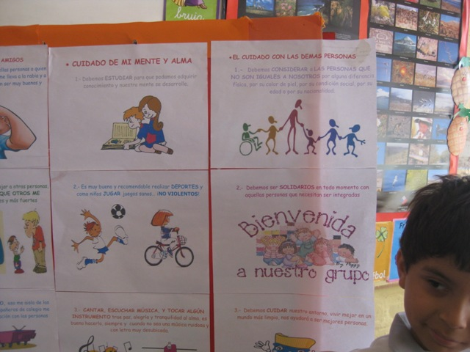
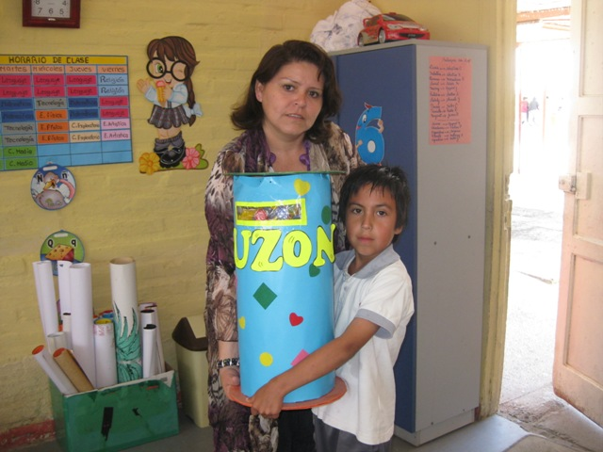
Culture of Care Teacher’s Guidelines
Care for myself, care for others and care for nature. Teacher Solange Araya

Slide 18
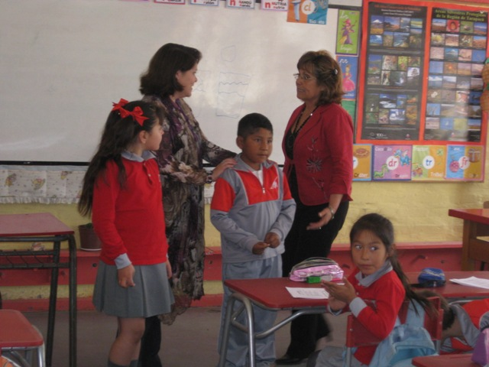
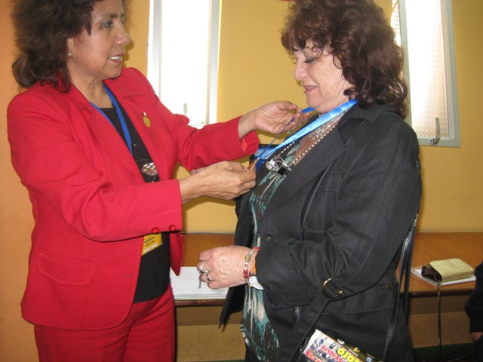
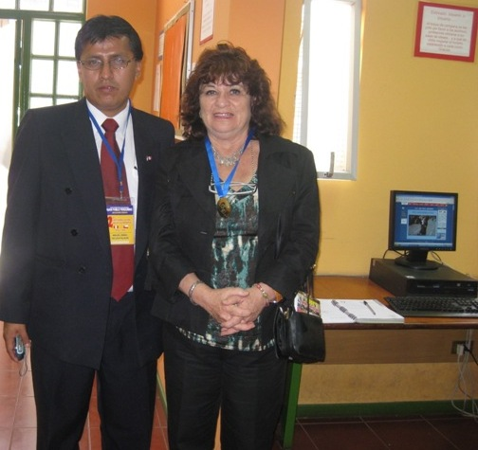
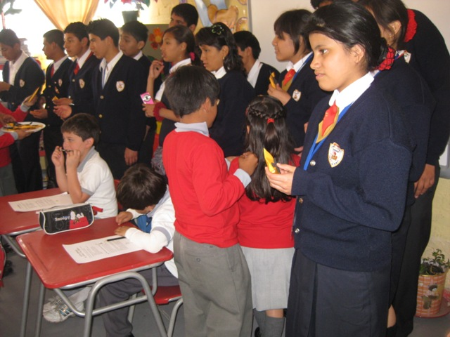
Principal Ana Soto and Gladys receive Special present (medal of school of Lima-Perú)

